Slide 1

BUS RESERVATION SYSTEM
LUKKA SHIVA CHARAN 103
B.JOSEPH 074
IT-’B’

Slide 2
Abstract
Our Mini Project is ‘Bus Reservation System’. We have taken this as our mini project inorder to conclude the problems faced by the people while booking the tickets. Our Bus Reservation System includes the features like login, members details, journey details payment and etc. We have added a new feature to the existing bus reservation system is that the person can select different boarding points to get into the bus. The one more additional thing is the person will be given a code while booking the ticket which he needs to enter while he is going to get down from the bus, so that we can keep a track of the person’s boarding and destination points. If in case the person get downs before the destination point which he has mentioned while booking the tickets, we will have the information of the person. We have increased the boarding points so that the person can his bus at a minimal distance of 20km from the boarding point. We have got 3-4 boarding points for the buses mentioned in the buses list. Through our bus services one can travel anywhere in a minimum possible time based on the buses routes. We have designed this to be a user friendly guide and take care of the users and respect their time and money as well.

Slide 3
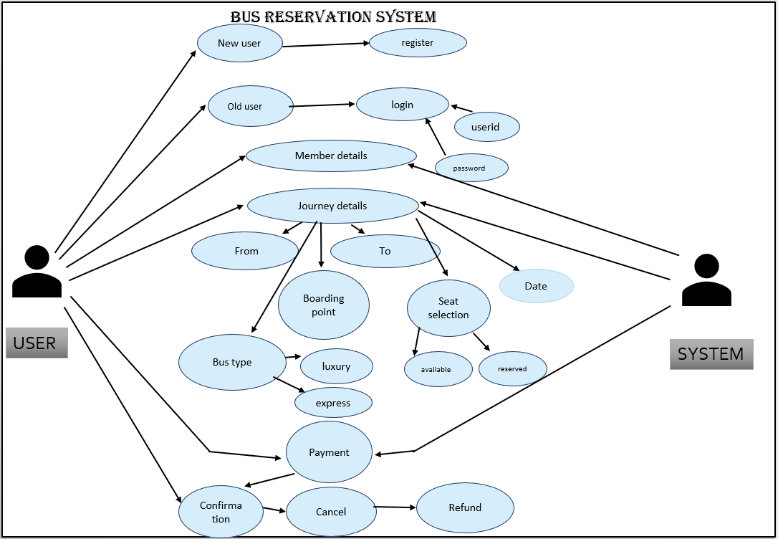
USE CASE DIAGRAM

Slide 4
Technology
SOFTWARE REQUIREMENTS
Software Requirements deal with defining the software resource requirements and prerequisites that need to be installed on a computer to provide optimal functioning of an application. These preconditions are generally not included in the software installation package and need to be installed separately.
In order to use CODIAC, one should have the following:
Operating System: Windows 7 and above
C Compiler: GNU Compiler Collection (GCC)
Editor: Any text editor .

Slide 5
HARDWARE REQUIREMENTS
Hardware requirements refer to the common set requirements defined by any operating system or software application and are usually the physical computer resources. In this, we look into the architecture, processing power, memory, secondary memory, display adapter and peripherals.
In order to use this project, one should have the following:
Processor: Intel Pentium processor and above
Memory: 4 GB RAM and above

Slide 6
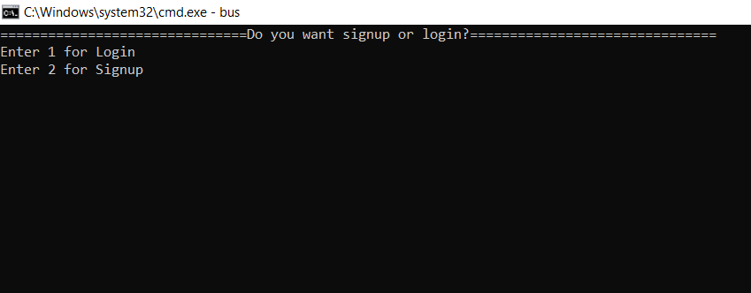
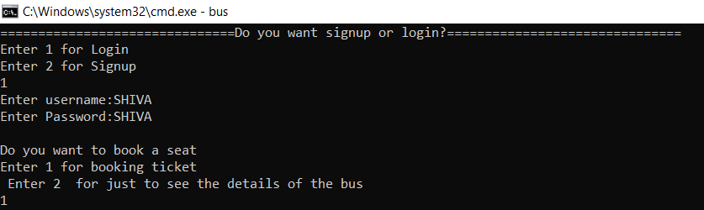
RESULT:
USING LOGIN OPTION

Slide 7
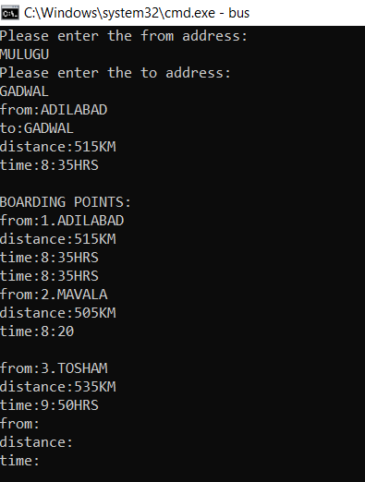
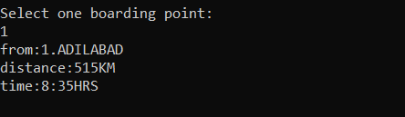

Slide 8
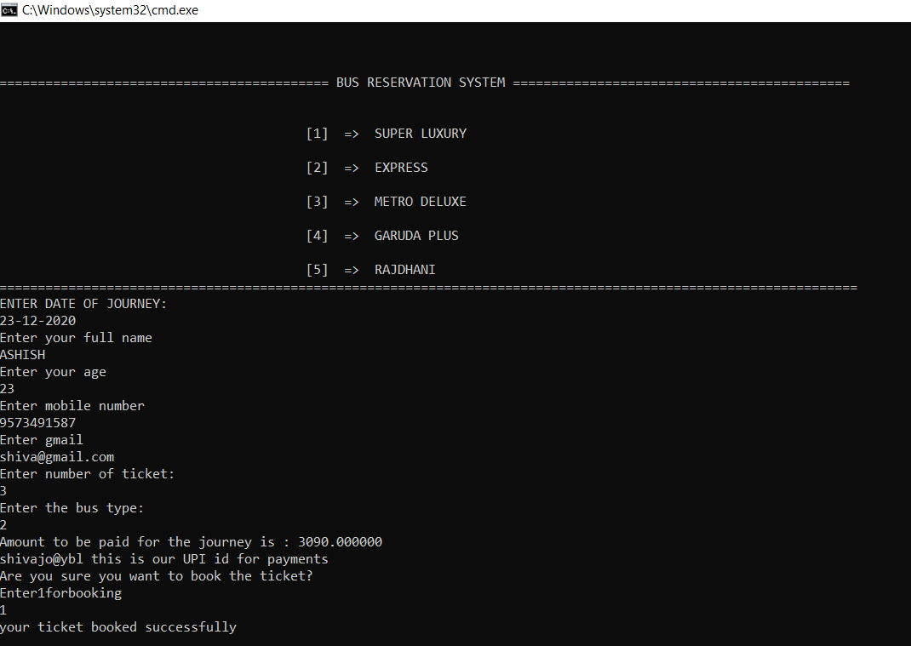

Slide 9
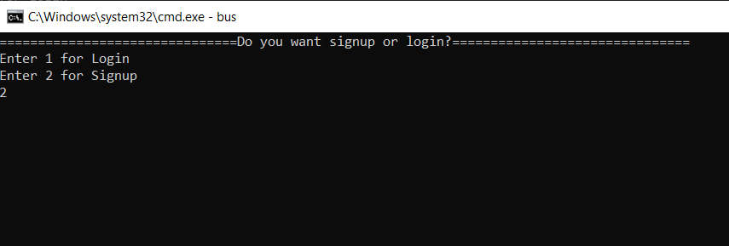
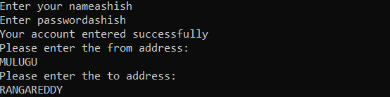
USING SIGNUP OPTION

Slide 10
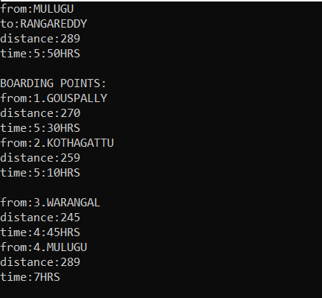
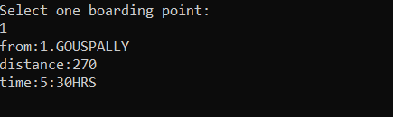

Slide 11
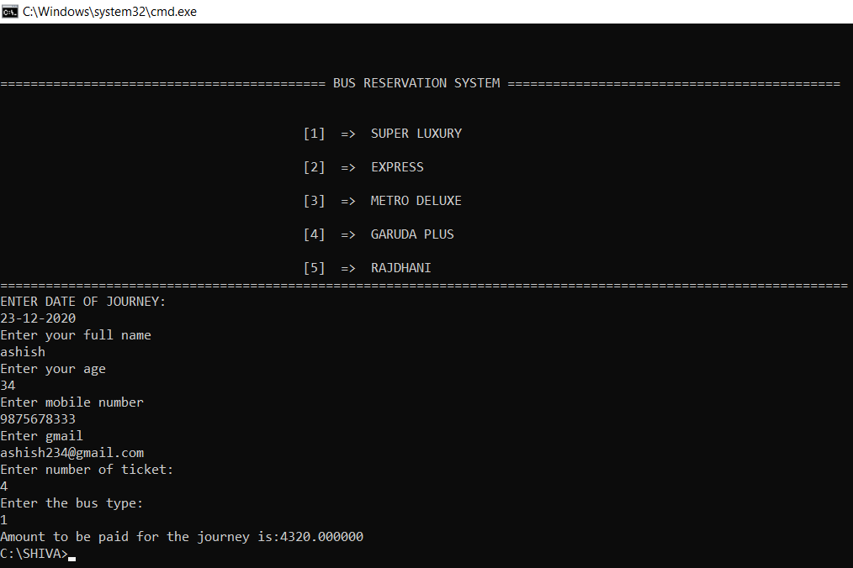

Slide 12
CONCLUSION AND FUTURE WORK
To conclude, this application is useful not only for Transport Department but It helps the user to understand everything and without any confusion can reserve a bus ticket.
Future work is to we develop the application in PHP Or HTML to make the real payment, make this console application as a web application.

